Slide 1
AngularJS + Asp.Net Web Api + SignalR：前後端整合篇
開發技巧實戰系列(3/6) - Web 前後端整合
講師: 郭二文 (erhwenkuo@gmail.com)
Notes:
開發技巧實戰
1. AngularJS入門篇
2. AngularJS + HighChart：完美網頁圖表整合篇
3. AngularJS + Asp.Net WebApi 2：前後端整合篇
4. AngularJS + Asp.Net WebApi 2+Entity Framework 6 (ORM)：前後端整合篇
5. AngularJS + Asp.Net WebApi 2+Entity Framework 6 (ORM) + Redis (Nosql)：前後端整合篇
6. AngularJS + Asp.Net WebApi 2+Entity Framework 6 (ORM) + Redis (Nosql) + Elasticsearch (全文檢索)：前後端整合篇

Slide 2
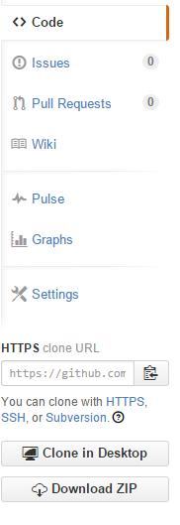
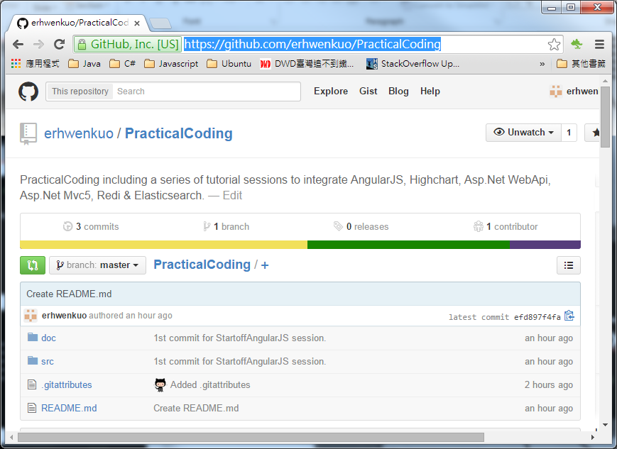

Document, Source code & Training Video (3/6)
https://github.com/erhwenkuo/PracticalCoding

Slide 3


Previous Training Session Document, Source code & Training Video (2/6)
https://www.youtube.com/watch?v=EVvC4YGXfDI
http://www.slideshare.net/erhwenkuo/02-integrate-highchart
Notes:
本章節的內容會延續前一個Session的知識與內容, 如果對前一章節不熟悉的話, 可以在Yoube或Slideshare找到文件與教學錄影

Slide 4
Agenda
Part_1
REST (Representational State Transfer)
Developing & Testing of ASP.Net Web API2
Highchart , AngularJS & Web API2 Integration
Part_2
Developing ASP.Net SignalR2
Highchart , AngularJS ,Web API2 + SignalR2 Integration

Slide 5
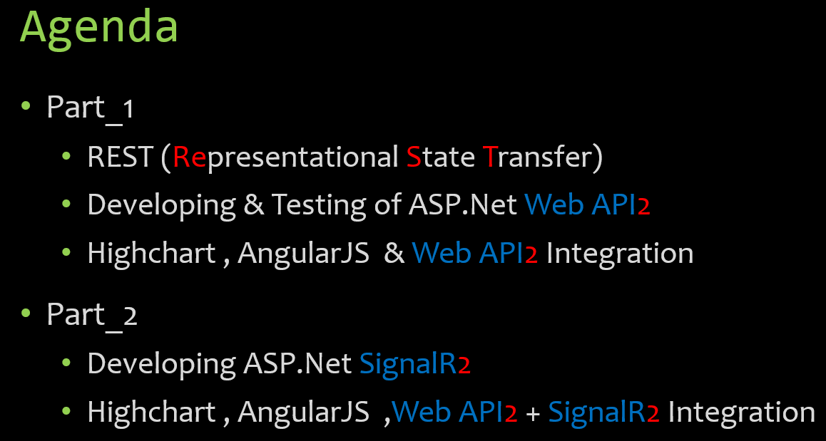
REST (Representational State Transfer)

Slide 6
What is REST?
REST stands for Representational State Transfer
REST is an architecture style for designing networked applications
RESTful applications use HTTP requests to post data (create and/or update), read data (e.g., make queries), and delete data
REST is a lightweight alternative to mechanisms like RPC (Remote Procedure Calls) and Web Services (SOAP, WSDL, et al.)
Notes:
什麼是REST跟RESTful?
REST 是一種分散式超媒體系統(如WWW)的軟體架構風格，
你可以想像它是一個良好設計的Web應用程式規則:
一組網路Web頁面(虛擬的狀態機器)，其中 Client 透過點選超連結(狀態變換)，
結果是下個Web頁面(表示應用程式的下一個狀態)。

Slide 7
Advantages Of REST
Separates server implementation from the client’s perception of resources (use standard HTTP GET/POST/PUT/DELETE verbs)
Scales well to large numbers of clients
Support intermediaries (proxies and gateways) as data transformation and caching components
Notes:
REST 有什麼優點?
在HTTP之上不依存其他機制跟軟體。
跟其他連結方式相比(如RPC)，可以提供相等的功能。
不需要其他的 discovery 機制，因為使用超連結了。
提供比RPC更好的長期相容性，因為 :
如同HTML這種文件具有後前及向後的相容能力
支援新的內容格式不需要丟掉舊的
支援快取 caching 將改善反應時間跟server的負載能力。
因為不必維持連結狀態，大大改善 server 的 scalability 能力。這表示不同server可以處理同一串 requests。
一個瀏覽器就可以存取任一應用程式跟資源，client 端不需使用別的軟體。

Slide 8
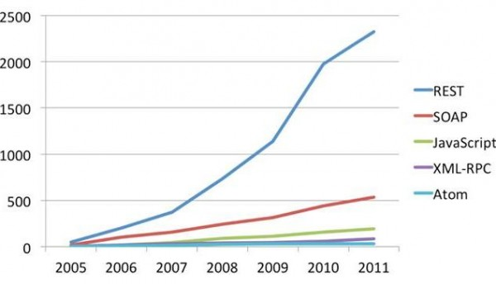
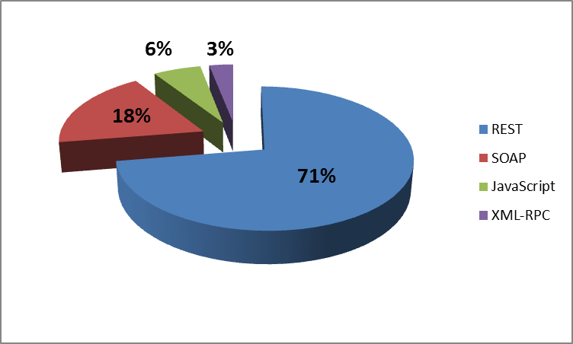
Protocol Usage by Web API
REST web api taking over SOAP web services
Google deprecated all SOAP web services and converted to REST web apis

Slide 9
Developing & Testing of ASP.Net Web API2

Slide 10
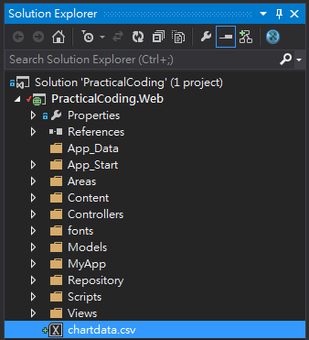
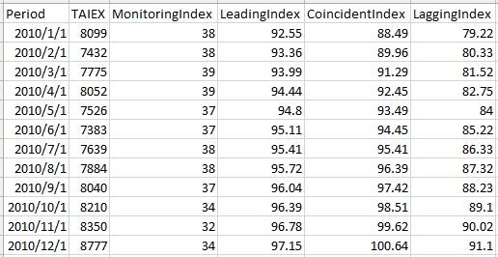
Develop WEP API to service Chartdata
In this portion, an Asp.Net Web API will be developed to server our Chartdata
Data Definition:
Period: 期間 (yyyy-MM-dd)
TAIEX: 台股加權指數
MonitoringIndex: 景氣對策信號
LeadingIndex: 景氣領先指標
CoincidentIndex: 景氣同時指標
LaggingIndex: 景氣落後指標
Data File Path
PracticalCoding\web\chartdata.csv
Notes:
axes.

Slide 11
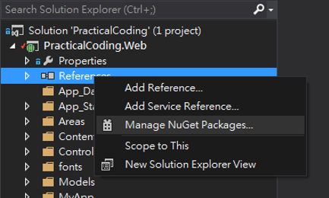

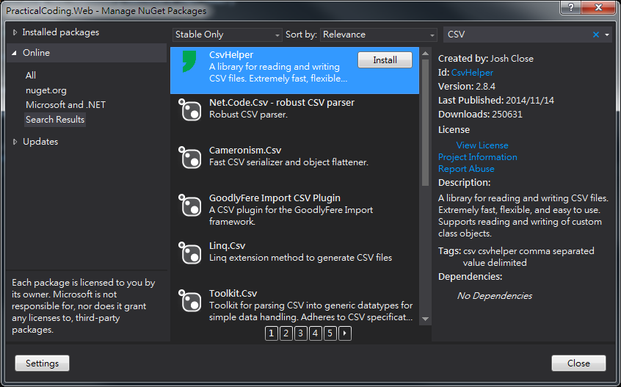

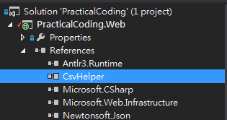

Install CsvHelper 3rd Party Library
Use NuGet to search CsvHelper
Click “Install”

Slide 12
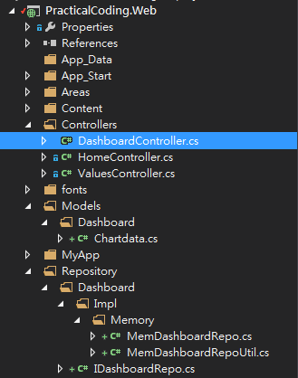
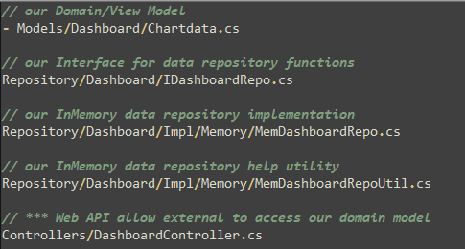
Web API demonstration Implementation
To create our Web API demonstration, below 5 files need to be created:
Notes:
There’s our HTML file. We will use Bootstrap to help with our styling. Notice that we also load up ui-router in addition to loading Angular. UI Router is separate from the Angular core, just like ngRoute is separate.
When creating a link with UI-Router, you will useui-sref. The href will be generated from this and you want this to point to a certain state of your application. These are created in your app.js.
We also use <div ui-view></div> instead of ngRoute’s <div ng-view></div>.

Slide 13
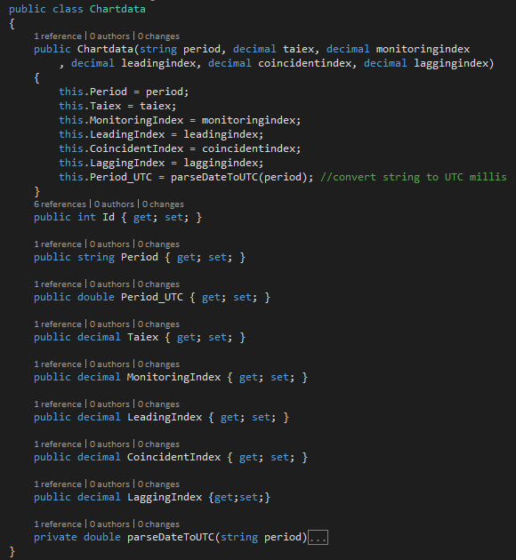
Chartdata.cs (1/5)
Create a POCO class to represent our Chartdata
Chartdata contain a private method “parseDateToUTC” is used to convert date string (yyyy/MM/dd) to milliseconds start from 1970/1/1 00:00:00

Slide 14
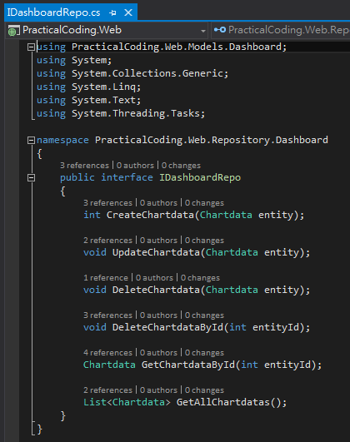
IDashboardRepo.cs (2/5)
Interface for most basic data repository functions (CRUD)
C (Create) → CreateChartdata
U (Update) → UpdateChartdata
D (Delete) → DeleteChartdataById
D (Delete) → DeleteChartdata
R (Query) → GetAllChartdatas
R (Query) → GetChartdataById
Why use interface?
It’s a good design/coding practice
Allow different implementation
Allow dynamic replacement

Slide 15
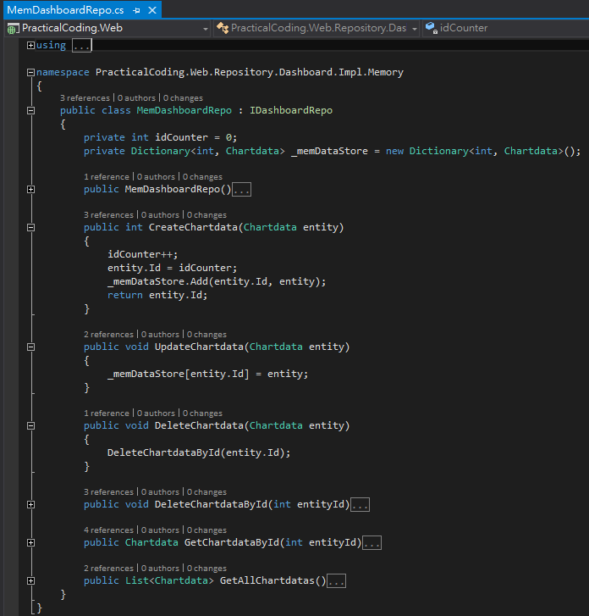
MemDashboardRepo.cs (3/5)
IDashboard Interface implementation using in-memory C# Dictionary object to hold our demonstration data
Notes: To simplify demonstration, there is no code to prevent multi-concurrent access/modification handling

Slide 16
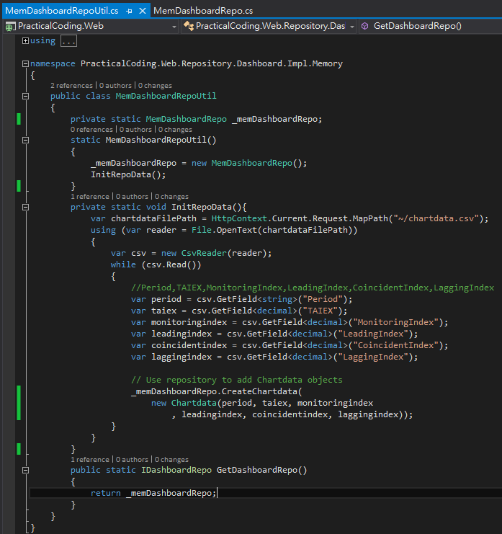
MemDashboardRepoUtil.cs (4/5)
A simple helper static class to keep one “MemDashboardRepo” object instance in memory
Load “chartdata.csv” data into “MemDashboardRepo” data store as initialization for demonstration
Why not use “Singleton” pattern
Just to simplify code and not confuse programmers who are not familiar with object oriented DESIGN PATTERNs

Slide 17
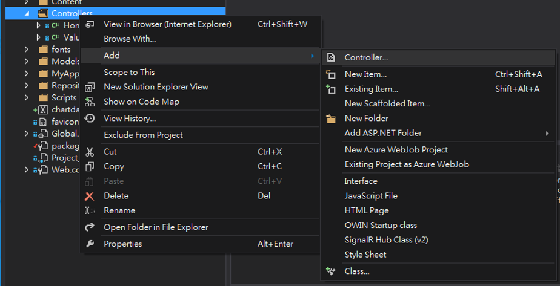
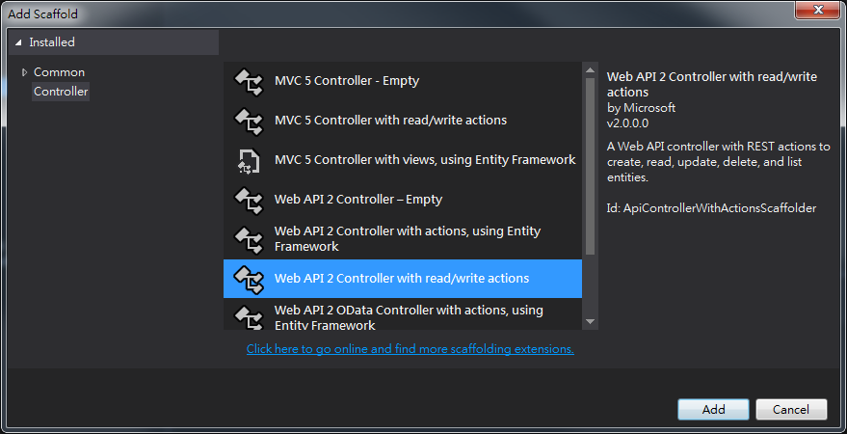
DashboardController.cs (5/5)
Choose “Controllers” folder
RighClick and choose below menu item
“Add” → “Controller…”
Choose “Web API2 Controller with read/write actions” template

Slide 18
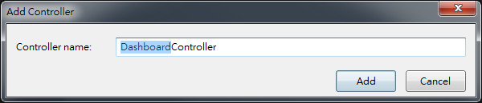
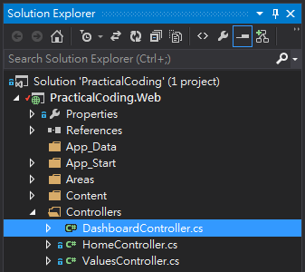
DashboardController.cs (5/5)
Change Controller name to “DashboardController”
A new class named “DashboardController.cs” should be created under “Controllers” folder

Slide 19
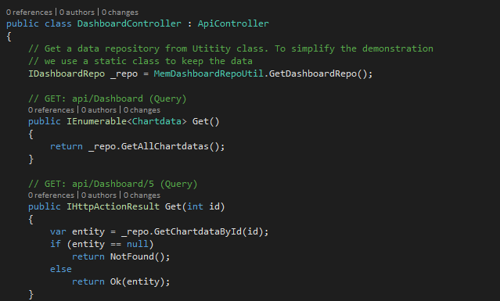
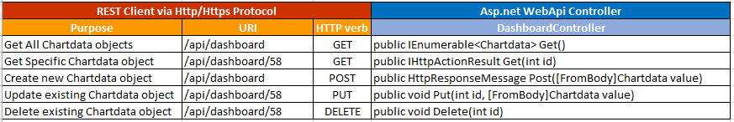
DashboardController.cs (5/5)

Slide 20
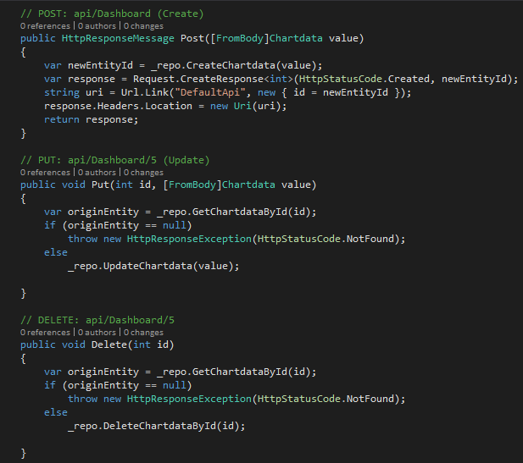
DashboardController.cs (5/5)

Slide 21
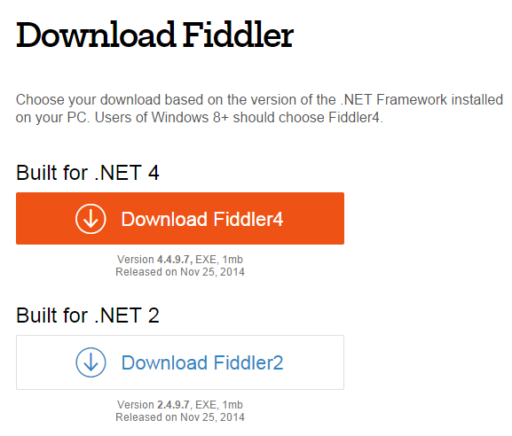
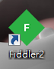
Testing ASP.Net Web API–GET, POST, PUT, DELETE using Fiddler2
What is “Fiddler2”
The free web debugging proxy for any browser, system or platform
Developed by “Telerick”
Where to get & install
Go to “Fiddler” download page “http://www.telerik.com/download/fiddler”
Click “Download Fiddler2” link
Execute “fiddler2set.exe”

Slide 22
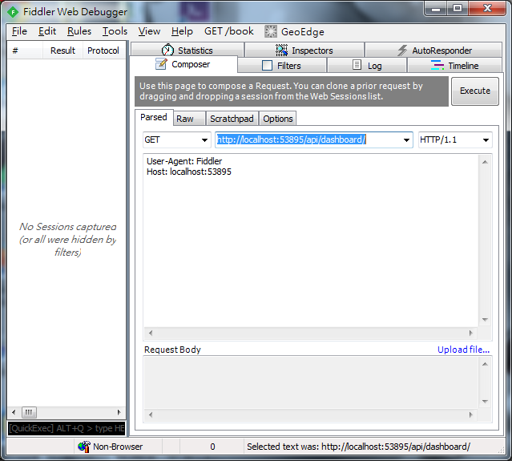
Testing ASP.Net Web API–GET
Demo
Hit “F5” to run “PracticalCoding.Web” project
Find the url and port, for example: “http://localhost:53895”
Click “Composer” Tab, Change method to “GET”, past our WebUrl with our web api path to Fiddler http://localhost:53895/api/dashboard/
Hit “Execute” button

Slide 23
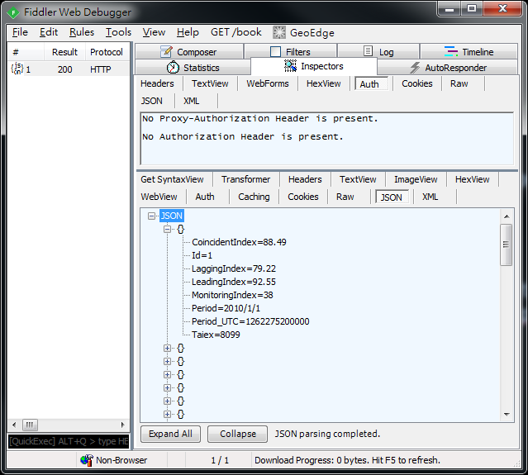
Testing ASP.Net Web API–GET Result
Demo
Http Status Code (200 – OK) in left panel
Click “JSON” Tab
A JSON object array contains 58 objects

Slide 24
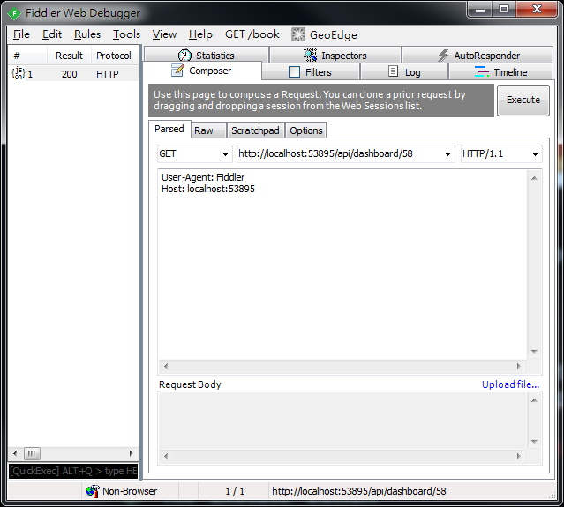
Testing ASP.Net Web API–GET
Demo
Hit “F5” to run “PracticalCoding.Web” project
Find the url and port, for example: “http://localhost:53895”
Click “Composer” Tab, Change method to “GET”, past our WebUrl with our web api path to Fiddler http://localhost:53895/api/dashboard/58
Hit “Execute” button

Slide 25
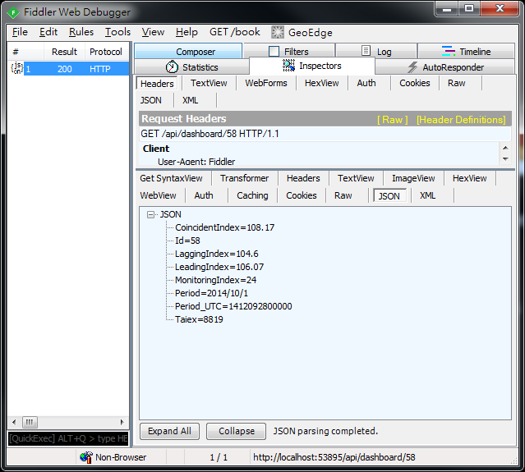
Testing ASP.Net Web API–GET Result
Demo
Click Http Status Code (200 – OK) in left panel
Click “JSON” Tab
A JSON object contains Chartdata object in JSON notation

Slide 26
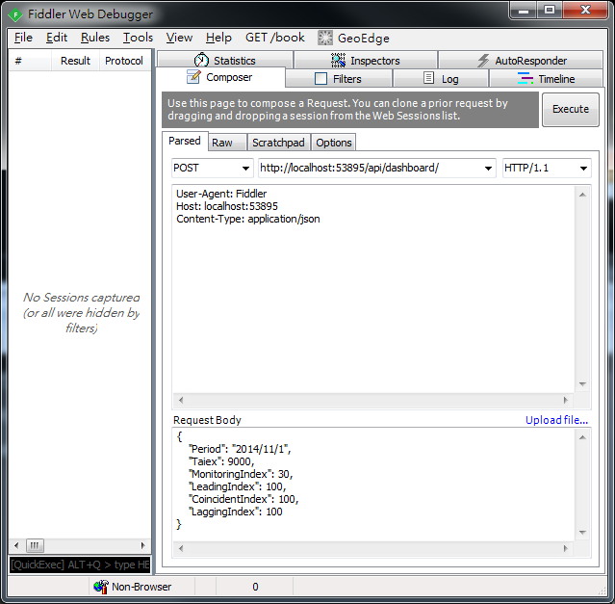
Testing ASP.Net Web API–POST
Demo
Click “Composer” Tab, Change method to “POST”, past our WebUrl with our web api path to Fiddler http://localhost:53895/api/dashboard/
Add “Content-Type: application/json” to indicates the content in the request body is JSON object
Hit “Execute” button

Slide 27
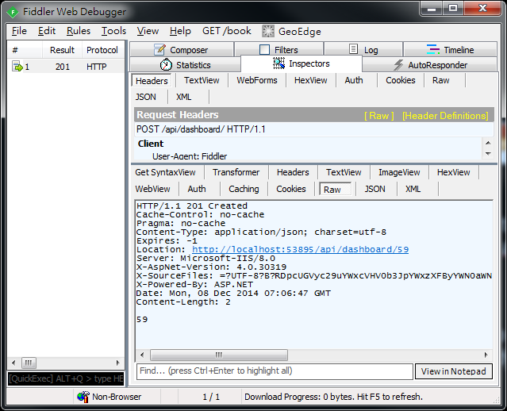
Testing ASP.Net Web API–POST
Demo
Click Http Status Code (201 – Created) in left panel
Click “Raw” Tab
“59” is the new Chartdata EntityId

Slide 28
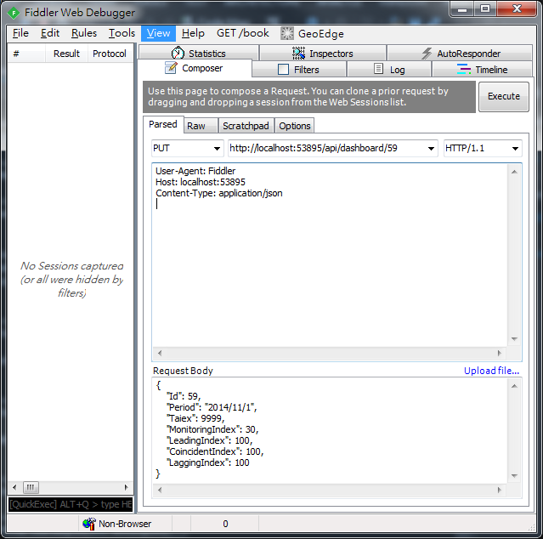
Testing ASP.Net Web API–PUT
Demo
Click “Composer” Tab, Change method to “PUT”, past our WebUrl with our web api path with EntityId to Fiddler http://localhost:53895/api/dashboard/59
Add “Content-Type: application/json” to indicates the content in the request body is JSON object
Put Entity Object in JSON style in “Request Body”
Hit “Execute” button

Slide 29
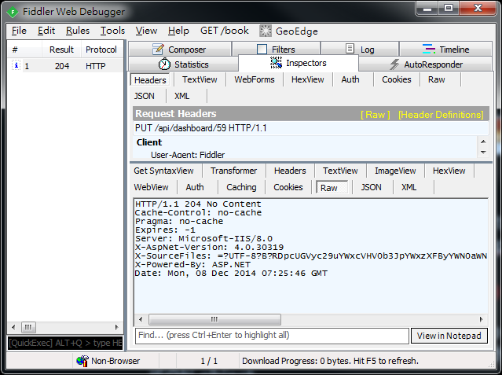
Testing ASP.Net Web API–PUT
Demo
Click Http Status Code (204 – No Content) in left panel

Slide 30
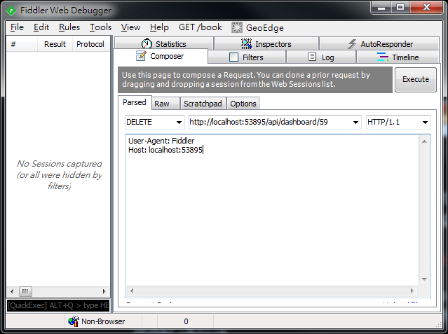
Testing ASP.Net Web API–DELETE
Demo
Click “Composer” Tab, Change method to “DELETE”, past our WebUrl with our web api path with EntityId to Fiddler http://localhost:53895/api/dashboard/59
Hit “Execute” button

Slide 31

Testing ASP.Net Web API–PUT
Demo
Click Http Status Code (204 – No Content) in left panel

Slide 32
Highchart , AngularJS & Asp.Net Web API2 Integration

Slide 33
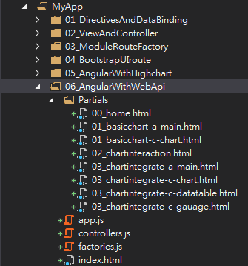
Setup SPA Folder
Copy “05_AngularWithHighchart” folder and paste as “06_AngularWithWebApi”

Slide 34
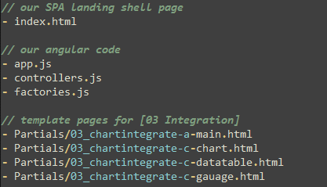
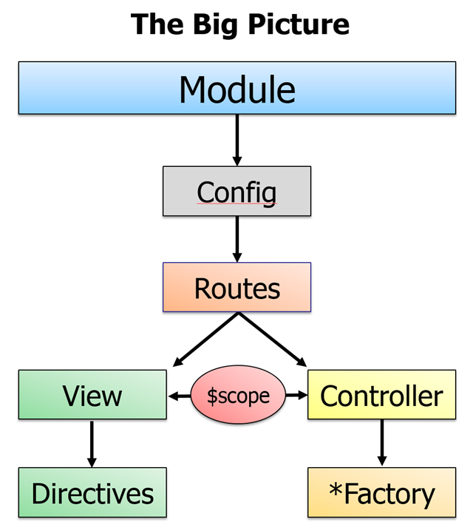
Integration with WebApi
The major code we need to change is “factories.js”
The key concepts (thinking in Angular) :
Encasuplate communication service with backend WebAPI via Factory module
Factory can easily be substituted or replaced if needed
“factories.js” contains code to demonstrate above points
The other code we need to change is “controllers.js”
Add more controller methods to support Create / Update & Delete operations

Slide 35
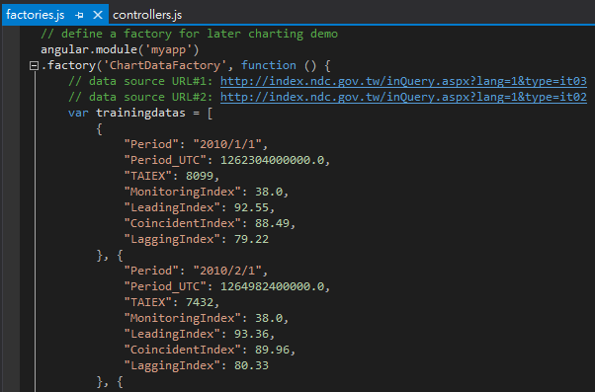
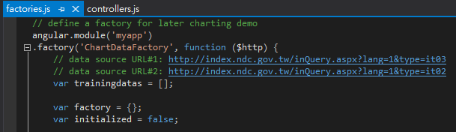
Integration with WebApi (factories.js)
Cleanup all static trainingdatas object array
Before
After

Slide 36
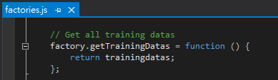
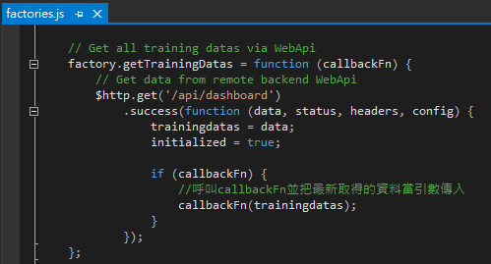
Integration with WebApi (factories.js)
Change “factory.getTrainingDatas” method to retrieve data from remote WebApi “/api/dashboard”
Before
After
Get the data via remote WebApi using angular $http service object
Get the data from local static variable
Notes:
axes.

Slide 37
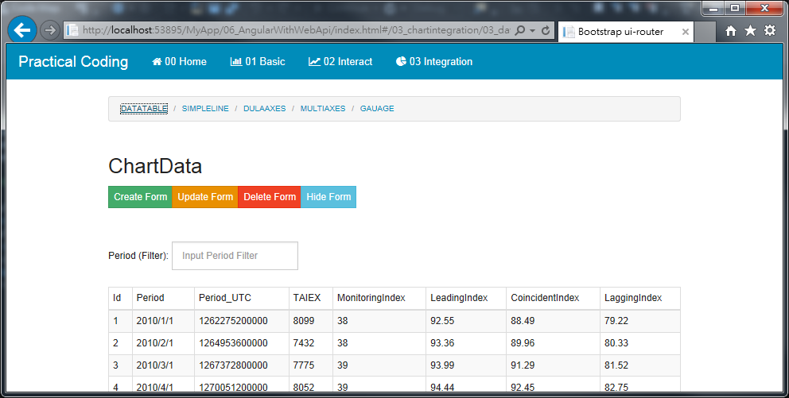
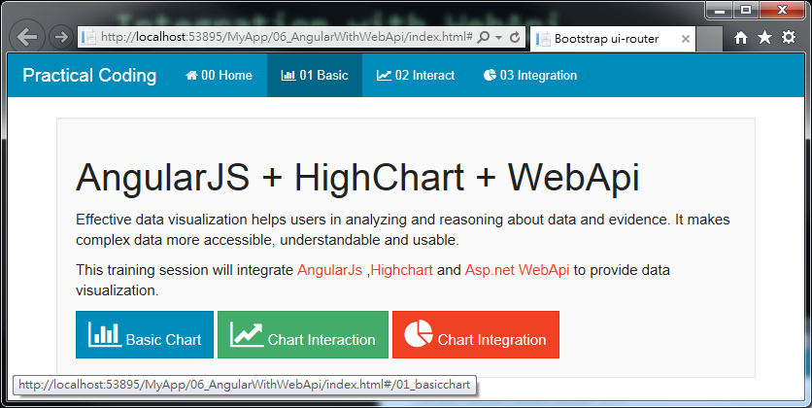
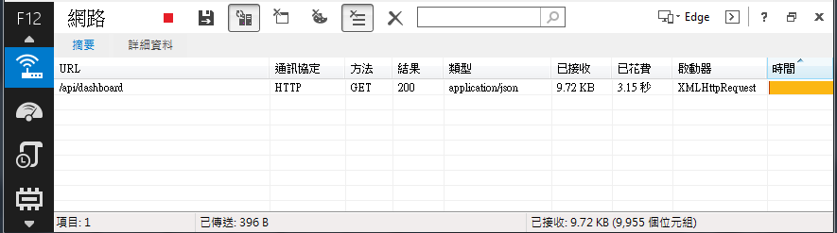
Integration with WebApi (Query)
Demo Page
Select “06_AngularWithWebApi” and Hit “F5” to run
Click “03 Integration→DATATABLE”
The result will show on a table also use Browser tools will show XHR result from WebApi

Slide 38
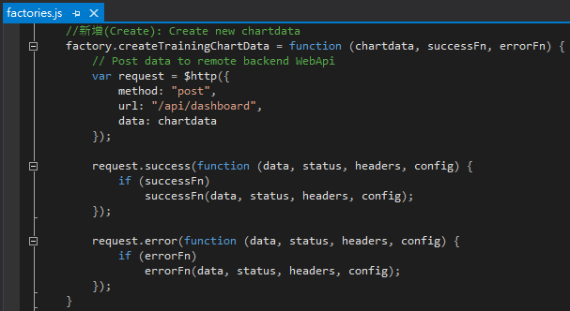
Integration with WebApi (factories.js) for Create
Add “factory.createTrainingData” method to POST data to remote WebApi “/api/dashboard” for creation operation
POST the data via remote WebApi using angular $http service object
If POST operation success, then execute this block
If POST operation error, then execute this block
Notes:
axes.

Slide 39
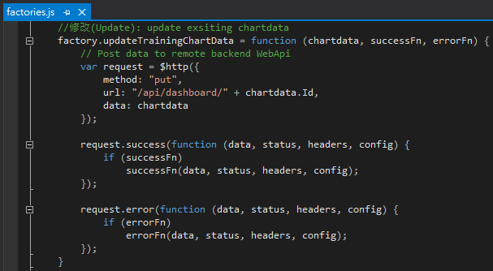
Integration with WebApi (factories.js) for Update
Add “factory.updateTrainingData” method to PUT data to remote WebApi “/api/dashboard/{id}”
PUT the data via remote WebApi using angular $http service object
If PUT operation success, then execute this block
If PUT operation error, then execute this block
Notes:
axes.

Slide 40

Integration with WebApi (factories.js) for Delete
Add “factory.deleteTrainingData” method to PUT data to remote WebApi “/api/dashboard/{id}”
DELETE the data via remote WebApi using angular $http service object
If DELETE operation success, then execute this block
If DELETE operation error, then execute this block
Notes:
axes.

Slide 41
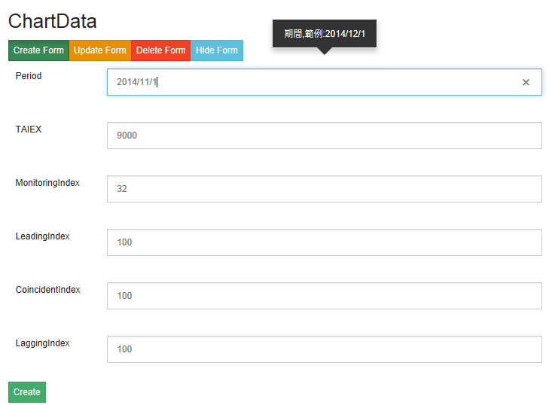
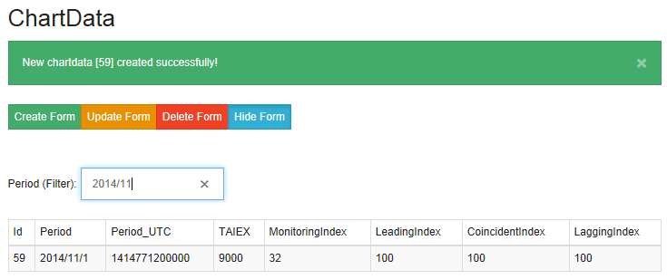
Integration with WebApi (Create)
Demo Page
Select “06_AngularWithWebApi” and Hit “F5” to run
Click “03 Integration ➔ DATATABLE ➔ Create Form”
Input all necessary data and Hit “Create”

Slide 42
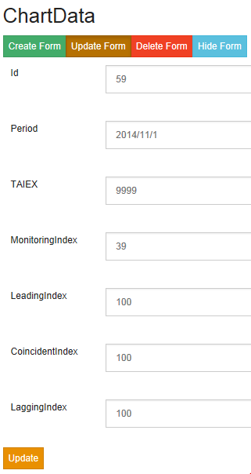
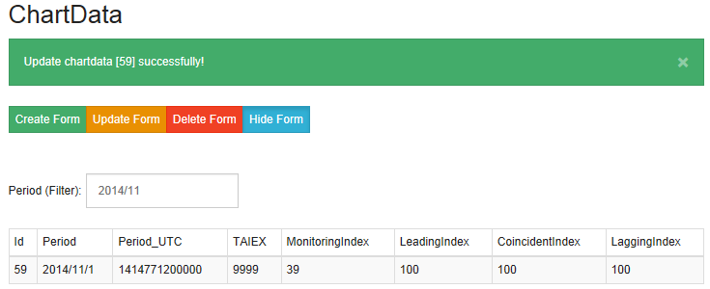
Integration with WebApi (Update)
Demo Page
Select “06_AngularWithWebApi” and Hit “F5” to run
Click “03 Integration ➔ DATATABLE ➔ Update Form”
Input all necessary data and Hit “Update”

Slide 43


Integration with WebApi (Delete)
Demo Page
Select “06_AngularWithWebApi” and Hit “F5” to run
Click “03 Integration ➔ DATATABLE ➔ Delete Form”
Input all necessary data and Hit “Delete”

Slide 44
Developing ASP.Net SignalR2

Slide 45


SignarR Web Resources
http://signalr.net
http://www.asp.net/signalr
Notes:
本章節的內容會延續前一個Session的知識與內容, 如果對前一章節不熟悉的話, 可以在Yoube或Slideshare找到文件與教學錄影

Slide 46

What is SignalR?
A library of adding real-time web functionality to Asp.Net applications
Real-time web functionality is the ability to have server code push content to connected clients instantly as it becomes available, rather than having the server wait for a client to request new data.
Notes:
ASP .NET SignalR 是一個ASP .NET下的類別庫，可以在ASP .NET的Web項目中實現實時通信。
什麼是即時通信(Real-time) 的Web呢？
就是讓客戶端（Web頁面）和服務器端可以即時也互相通知消息及調用方法。
WebSocket s是HTML5提供的新的API，可以在Web網頁與服務器端間建立Socket連接，
當WebSockets可用時（即瀏覽器支持Html5）SignalR使用WebSockets，
當不支持時SignalR將使用其它技術來保證達到相同效果。
SignalR當然也提供了非常簡單易用的高階API，使服務器端可以單個或批量調用客戶端上的JavaScript函數，並且非常方便地進行連接管理，例如客戶端連接到服務器端，或斷開連接，客戶端分組，以及客戶端授權，使用SignalR都非常容易實現。

Slide 47

Environment Setup
Use NuGet to search “SignalR”
Click “Install”

Slide 48



Environment Setup
Add “OWIN Startup class” named “Startup.cs” under “ProjectCoding” webroot
Input “app.MapSignalR();” as show below

Slide 49




Simple SignalR Chat Application (JQUERY)
Create below files to build a simple SignalR Chat application

Slide 50


Simple SignalR Chat Application (JQUERY) – Server “ChatHub.cs”
Add new item -> “SignalR Hub Class(v2)” -> “ChatHub.cs”
A method which can used to broadcast a message to all SingnalR connected Clients

Slide 51


Simple SignalR Chat Application (JQUERY) – Client Html

Slide 52
Simple SignalR Chat Application (JQUERY)
Demo
Select “07_SignalRChat/01_SimpleChat_Jquery.html” and Hit “F5” to run
Open Multi-Browers to chat with each other

Slide 53



Simple SignalR Chat Application (AngularJs)
Create below files to build a simple SignalR Chat application using AngularJS

Slide 54

Create SignalR Hub class
Add new item -> “SignalR Hub Class(v2)” -> “ChatHub2.cs”
A method which can used to broadcast a message to all SingnalR connected Clients except message issuer
A simple POCO class as communication message object

Slide 55

AngularJs Module wrapped SignalR
https://github.com/JustMaier/angular-signalr-hub

Slide 56

Find Good Bootstrap UI Style Template
http://bootsnipp.com

Slide 57

02_SimpleChat_Angular.html

Slide 58

02_SimpleChat_Angular.html
Ask AngularJS to inject “chatHubFactory”
Ask AngularJS to inject “$rootScope”

Slide 59
Simple SignalR Chat Application (AngularJS)
Demo
Select “07_SignalRChat/02_SimpleChat_Angular.html” and Hit “F5” to run
Open Multi-Browers to chat with each other

Slide 60


Simple SignalR Chat Application (EventBus)
The drawback of previous Chat application sample
Tightly coupled – Client and Server Hub are very tight coupled, think about how many Server Hubs class we need to create for different scenarios?
Let’s refactoring previous SignalR Chat application using “EventBus” concept

Slide 61


Create SignalR Hub class
Add new item -> “SignalR Hub Class(v2)” -> “EventBusHub.cs”
Add new POCO class “SignalREvent.cs”
A simple POCO class as communication message object
A method which can used to broadcast a message to all SingnalR connected

Slide 62



Create Customise AngularJS “EventBus” module

Slide 63

UI AngularJS Code
Delegate message sending via “EventBusHub”
Only listen “Event” whatever this UI interesting

Slide 64


Simple SignalR Chat Application (EventBus)
Demo
Select “07_SignalRChat/02_SimpleChat_EventBus.html” and Hit “F5” to run
Open Multi-Browers to chat with each other

Slide 65
Highchart , AngularJS ,Web API2 + SignalR2 Integration

Slide 66

Integration with SignalR
Copy “06_AngularWithWebApi” to “08_AngularWithSignalR ”

Slide 67


Integration with SignalR – **SignalRDashboardController.cs (WebApi)**
Copy “DashboardController.cs” to “SignalRDashboardController.cs”
Get SignalR “EventBus” Hub Context reference
Notes:
axes.

Slide 68

Integration with SignalR – **SignalRDashboardController.cs (WebApi)**
Add below code block in WebApi “Post (Create)” method to broadcast a “SignalREvent”

Slide 69

Integration with SignalR – **SignalRDashboardController.cs (WebApi)**
Add below code block in WebApi “PUT (Update) ” method to broadcast a “SignalREvent”

Slide 70

Integration with SignalR – **SignalRDashboardController.cs (WebApi)**
Add below code block in WebApi “Delete” method to broadcast a “SignalREvent”

Slide 71

Integration with SignalR
Modify “index.html” to include “SignalR” related javascripts
Notes:
axes.

Slide 72

Integration with SignalR
Modify “app.js” to have AngularJS include “EventBus” module
Notes:
axes.

Slide 73


Integration with SignalR
Modify “controllers.js -> 03_myapp_integrateDataTableCtrl” to listen SignalREvent published by “EventBus”
Inject “EventBusHub”
Notes:
axes.

Slide 74


Integration with SignalR
Modify “factories.js -> 03_myapp_integrateLineCtrl” to listen SignalREvent published by “EventBus” and refresh chart
Modify “factories.js -> 03_myapp_integrateDualAxesCtrl” to listen SignalREvent published by “EventBus” and refresh chart
Modify “factories.js -> 03_myapp_integrateMultiAxesCtrl” to listen SignalREvent published by “EventBus” and refresh chart
Modify “factories.js -> 03_myapp_integrateGauageCtrl” to listen SignalREvent published by “EventBus” and refresh chart
Notes:
axes.

Slide 75



Integration with SignalR
Demo
Select “08_AngularWithSignalR/index.html” and Hit “F5” to run
Open Multi-Browers to see charts reflect changes whenever C/U/D operations occurred

Slide 76


Next Session: AngularJS + Highchart + Asp.Net WebApi2 + SignalR2 + Entity Framework6

